Slide 1
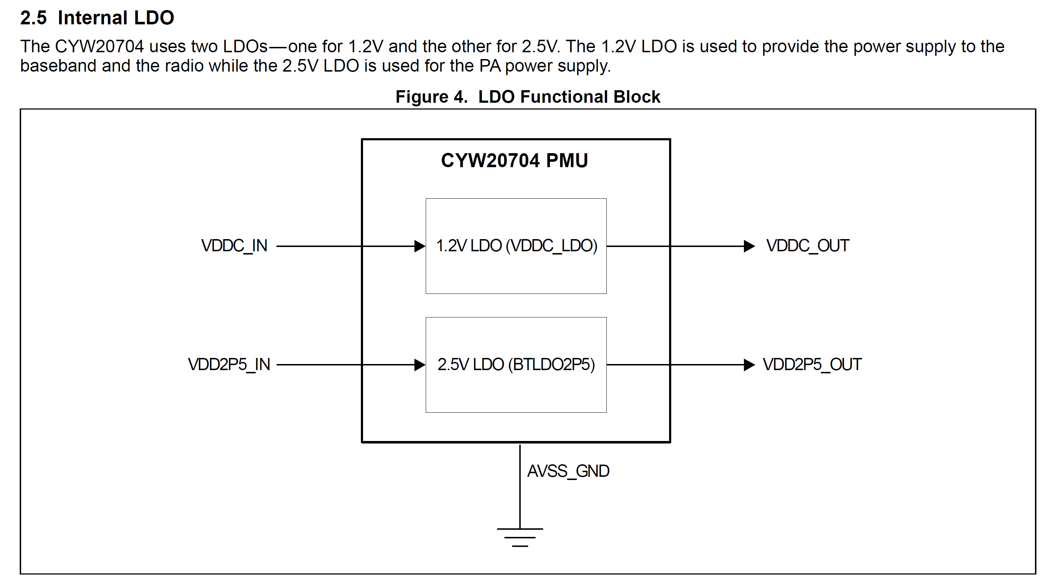
1. Which pin is VDDC_IN?
Pin assign
VDDC_IN:
VDDC -> B8, G6
Pin assign
VDDC_OUT:
F1

Slide 2
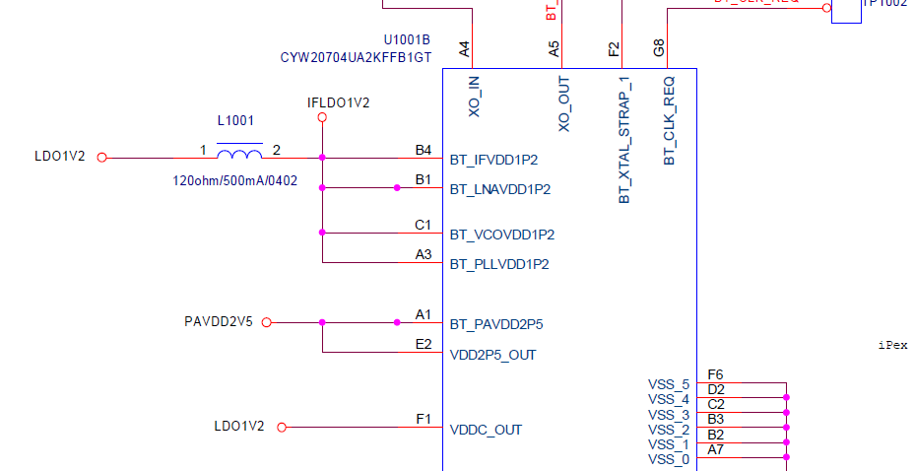
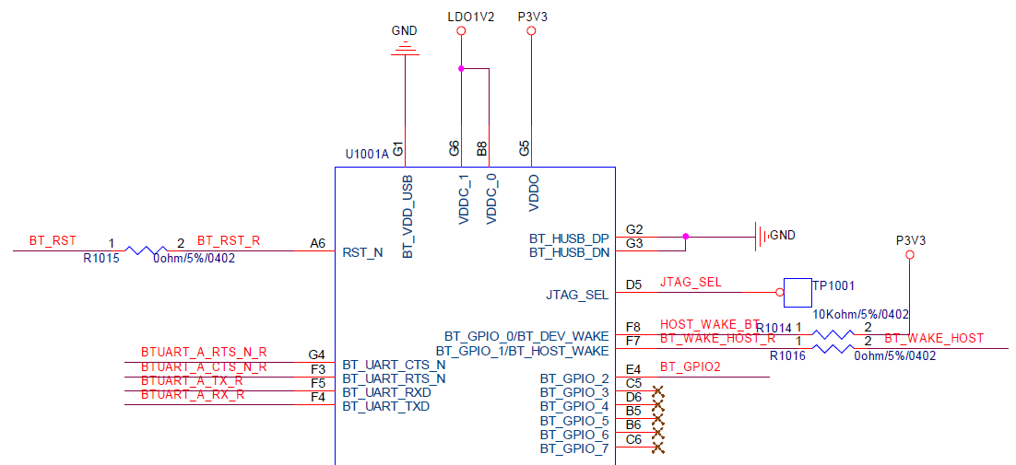
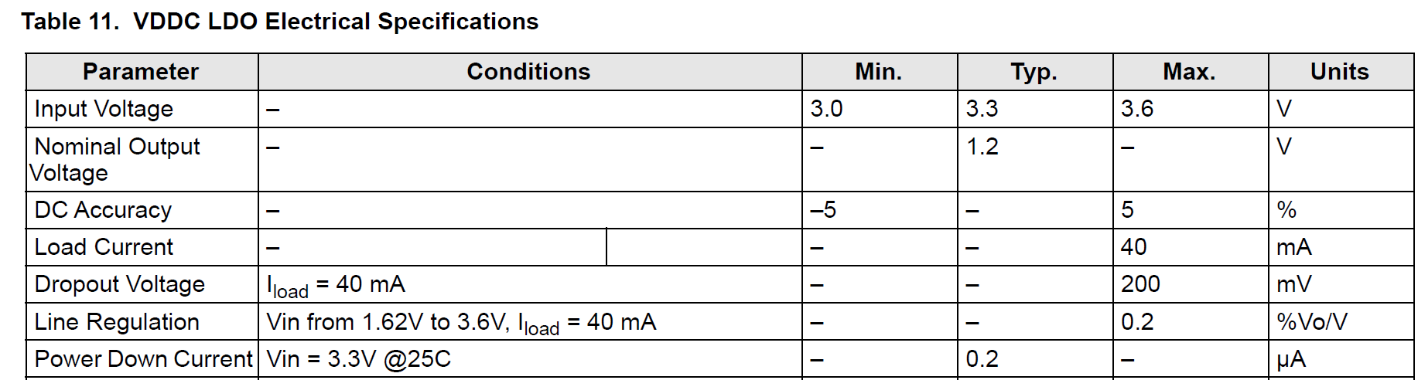
Which pin is VDDC_IN?
If VDDC_IN is VDDC(B8,G6), your schematic is wrong.
Your schematic presented VDDC_OUT(F1) -> VDDC_0 &1(B8, G6): Power flow
And VDDC Input voltage range presented to 3.0~3.6V(refer to below specification)

Slide 3
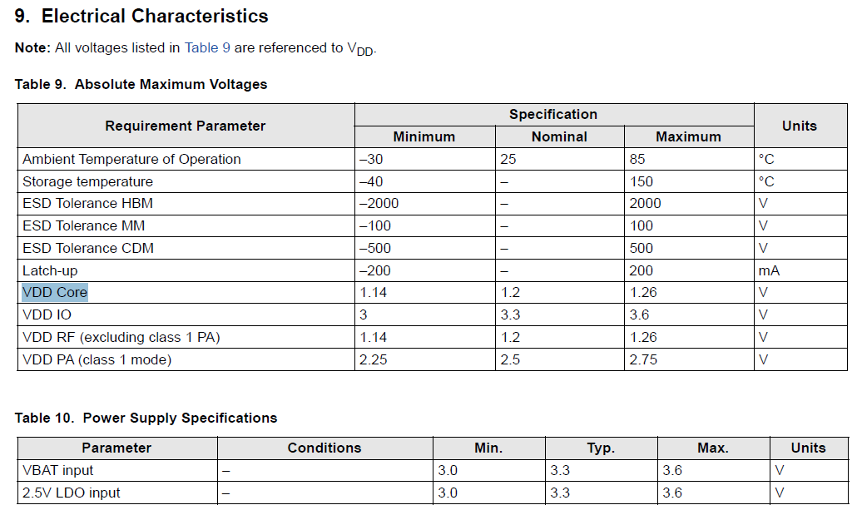
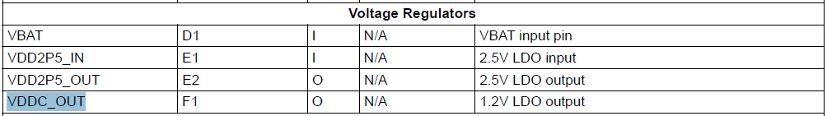
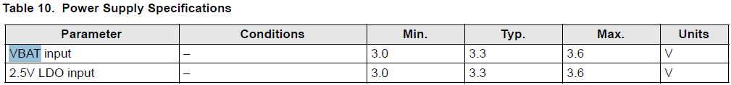
Fii’s feedback
As we know, VDDC (G6&B8) is core logic supply and should be supplied by internal LDO 1.2V output.
And we think the VDDC IN should be VBAT which is the main voltage regulator input for internal LDO use.

